Slide 1
Understanding the College Process
By Elizabeth Barrett

Slide 2
Welcome to college process night!
Thank you for coming!
Let’s take the stress out of this process by working together!
Your daughters are all going to have many wonderful options!
Finding the right match!

Slide 3
Where do we start?
What do colleges want?
What do you and your daughter want?
What is the process?
Who does what?

Slide 4
What do colleges want?
Good grades
Good test scores on SAT or ACT
Challenging courses
Extracurricular activities
Well-written, insightful essay
Letters of recommendations from teachers and the guidance counselor
Volunteer work
Work experience
Special talents or abilities (sports, leadership, music, art, computers, etc)

Slide 5
DREXEL UNIVERSITY 76% ACCEPTANCE RATE
VERY IMPORTANT
Academic grade point average
Class rank
Rigor of coursework
SAT/ACT test scores
IMPORTANT
Application Essay
Character/Personal Qualities
Recommendations
CONSIDERED
Alumni Relation
Extracurricular Activities
First generation college student
Interview
Level of Applicant's Interest
Talent/Ability
Volunteer Work
Work Experience

Slide 6
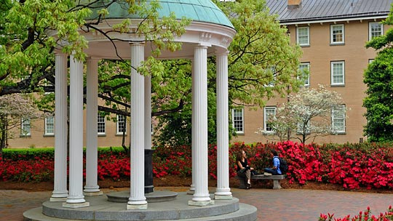
University of North Carolina –Chapel Hill 37% ACCEPTANCE RATE
VERY IMPORTANT
Application Essay
Character/Personal Qualities
Extracurricular Activities
Recommendations
Rigor of secondary school record
Standardized Test Scores
State Residency
Talent/Ability
IMPORTANT
Academic GPA
Class Rank
Volunteer Work
Work Experience
CONSIDERED
Alumni Relation
First generation college student
Racial/Ethnic Status

Slide 7
What do you and your daughter want?
Good school with a good reputation
A school that is safe
Good professors that care about their students
Right major/a good program
Successful
Happy

Slide 8
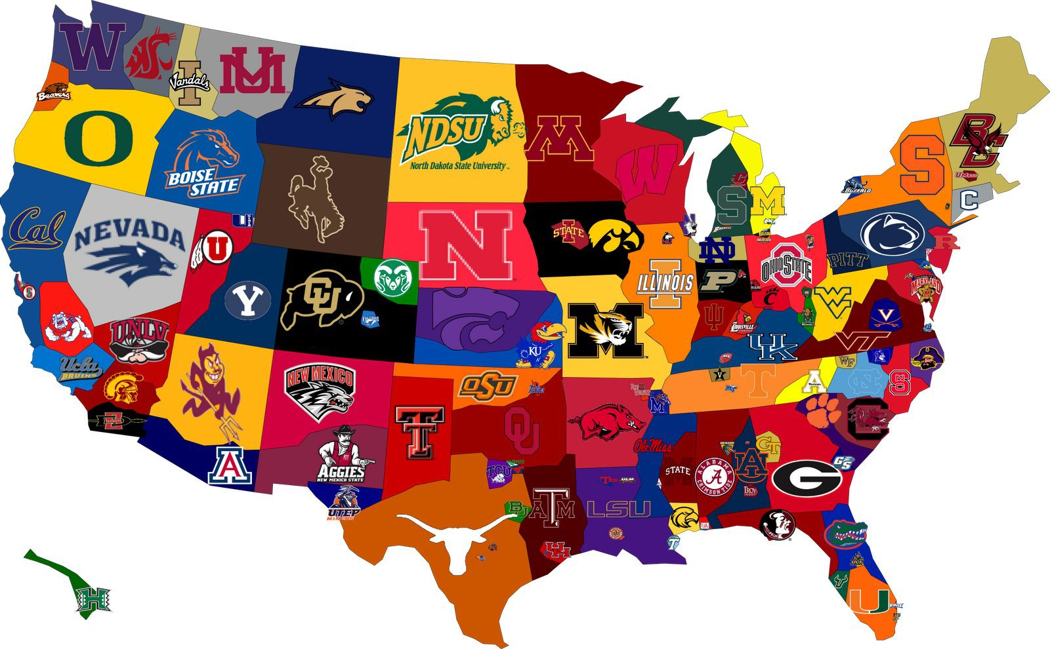
Finding the right match
Size
Type: private or public
Location/Setting
Residential Setting
Selectivity (gpa, tests)
Major/areas of interest
Sports/Activities
Cost/scholarships

Slide 9
Collegeboard.org
Collegeboard.org has a great college search feature.
Your daughters are very familiar with this site.
They all have an account.
-PSAT, SAT, AP tests
They have all begun to generate a college list.
www.collegeboard.org/collegesearch

Slide 10
The application process
The Common Application vs. Individual College Application
“The Common App” has over 600 colleges: private/public
All 8 Ivy League schools
Create an account and track progress
The Common App allows me to track progress as well.

Slide 11
Ivy Leagues on the Common App
All eight Ivy League schools are on the Common App.
(Brown, Columbia, Cornell, Dartmouth, Harvard, Princeton, University of Pennsylvania, Yale)
As well as other top schools like Stanford, University of Chicago, Caltech, Johns Hopkins, Northwestern, Vanderbilt, and Rice accept the Common Application.

Slide 12
Application elements (Use your admissions counselor!)
YOUR PART
MY PART
Application (I will help!)
Essay & Supplements (We will help!)
Letters of Recommendation
-Ask and remind
-Invite them on the CA
FAFSA and CSS Profile
MONITOR REGULARLY!!!
Transcript
VVA Profile
Letters of Recommendation
-Electronic copy
-Remind them
-Monitor them
Mid-year report and final transcript

Slide 13
deadlines
Rolling Admissions: “First come, first serve”
Early Action, Early Decision, Regular Decision
-Early Action and Early Decision deadlines: Nov. 1 or Nov. 15
-Early Decision is binding.
Regular Decision deadlines: January 1 or February 1
The Common App opens August 1

Slide 14
SAT and ACT testing
*Test-optional schools (Fairtest.org)
*All schools accept both.
*Last year ACT was more popular.
*East coast is more familiar with SAT.
*Most schools super-score.
*Official scores

Slide 15
scholarships
Most merit based are automatic. See website.
Athletic scholarships: NCAA Division I and II
ROTC scholarships: apply
Financial Aid: FAFSA and the CSS Profile

Slide 16
Resources for $$$
Scholly App - $2.99
About.com –college scholarships
Fastweb.com
www.villavictoria.org -MY WEBSITE
Look at your college’s websites
Look at your local high school’s website
Work with your college’s financial aid office (Woolfolk)
Look into your own company!
Look everywhere!

Slide 17
Getting a head start!
Guidance Seminar Classes Junior year meet weekly.
Your daughters have been getting ready!
-Attend college visit sessions in the fall
-Analyzed PSAT scores and discussed a plan for SAT/ACT Tests
-Generate a college list
-Create a resume
-Create a Common Application account and practice
-Write a practice essay
-Ask teachers for letters of recommendation
-Summer and weekends are a great opportunity!

